Slide 1
Learning on RNN
Instructor: Dr. Yan Yan

Slide 2
Learning Target
other
dest
other
0
…
1
…
0
…
…
…
…
0
1
0
0
1
0
y¹
y²
y³
copy
copy
a¹
a²
a³
a¹
a²
W^{i}
x¹
x²
x³
Training
Sentences:
arrive Taipei on November 2nd
other
dest
other
time
time

Slide 3
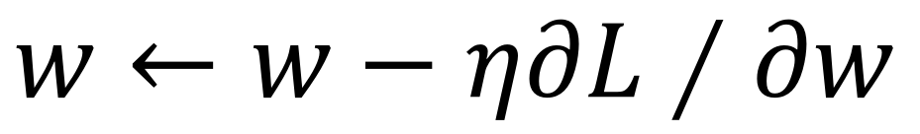
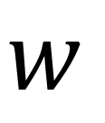
Learning
Backpropagation through time (BPTT)
copy
$$w$$
$$w←w−η∂L∕∂w$$

Slide 4
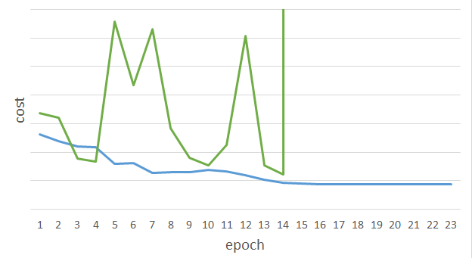
Unfortunately ……
RNN-based network is not always easy to learn
Real experiments on Language modeling
sometimes
Total Loss
Lucky
Epoch

Slide 5
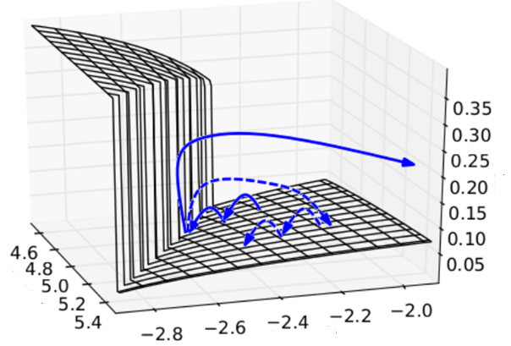

The error surface is rough.
The error surface is either very flat or very steep.
Clipping
Cost
Total Loss
w₂
w₁
[Razvan Pascanu, ICML’13]

Slide 6
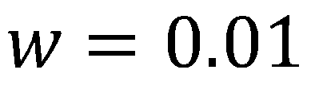
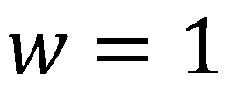
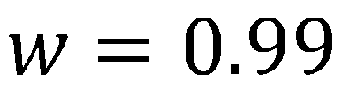
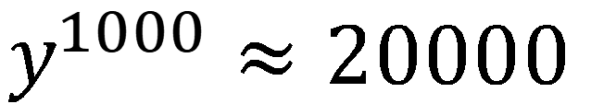
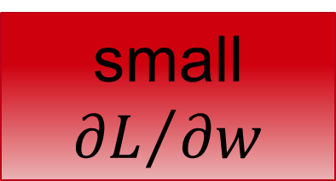
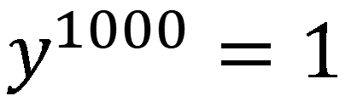
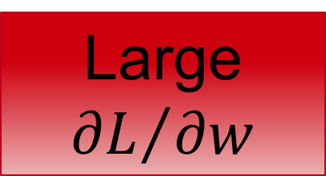
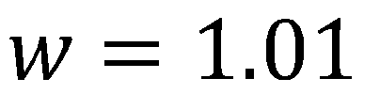
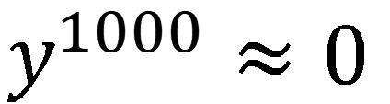
Why?
$$w=1$$
$$y^{1000}=1$$
Large
$${∂L}/{∂w}$$
Small Learning rate?
$$w=1.01$$
$$y^{1000}≈20000$$
$$w=0.99$$
$$y^{1000}≈0$$
small ${∂L}/{∂w}$
Large Learning rate?
$$w=0.01$$
$$y^{1000}≈0$$
=w⁹⁹⁹
y¹
y²
y³
y¹⁰⁰⁰
Toy Example
1
1
1
1
……
w
w
w
1
1
1
1
1
0
0
0

